Slide 1
Writing a Report! To report or not to report?
Khurshid Ahmad
Professor of Computer Science
Department of Computer Science,
Trinity College, Dublin, Ireland.
Presentation for Trinity CS under-graduates,
November 29th, 2013, Dublin, Ireland
1

Slide 2
Writing a Report
GHOTI
Grand statement of what you have done
Humble account of what others have done before you did what you did
Objective statement of how you propose to do – methods, algorithms
Talking through what you have done by an exemplar
Implications of what you have done

Slide 3
Writing a Report
A report contains
facts, inferences from facts;
opinions, speculations.
A good report clear flags facts and has evidence to support the existence of the facts.
A good report marks out the beginning and end of an opinion/speculation
A report is only submitted after many revisions

Slide 4
Writing a Report
A report contains
facts, inferences from facts;
opinions, speculations.
A good report clear flags facts and has evidence to support the existence of the facts.
A good report marks out the beginning and end of an opinion/speculation
A report is only submitted after many revisions

Slide 5
Writing a Report
A report is a narrative and it has a structure:
A beginning
A middle and
An end
A report written by a professional always comprises references to sources, e.g. published facts/opinions
A report should your work and yours only; plagiarism can be detected very easily

Slide 6

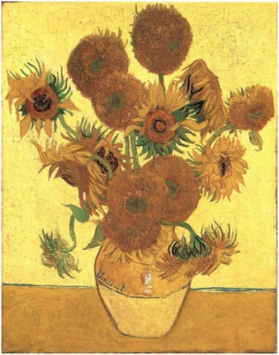
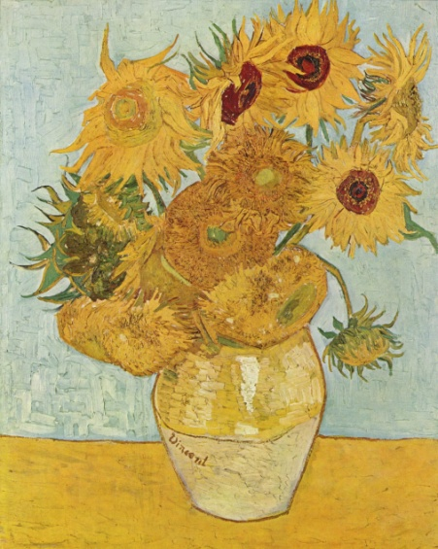
Writing a Report
What is a narrative?
Narrate how your day has been?
Narrate what you see in this image:

Slide 7
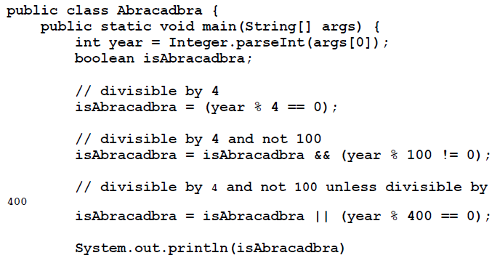
Writing a Report
What is a narrative?
Narrate this program

Slide 8
Writing a Report
What is a narrative?
Narrate what this program does

Slide 9
Writing a Report
GHOTI
gh, pronounced /f/ as in tough /tʌf/;
o, pronounced /ɪ/ as in women /ˈwɪmɪn/; and
ti, pronounced /ʃ/ as in nation /ˈneɪʃən/.
GHOTI → FISH

Slide 10
Writing a Report
GHOTI → FISH
Your report should be like an (ideal) fish
Thin at either ends, fat in the middle

Slide 11
Writing a Report
Good communication is extremely important –
Motivate the reader
Structure the Report
G: Introduction → Your work, context, structure, results
H: Literature Review → What motivated you?
Set the scene/produce a critique
O: Method → How will you do what you have to do?
T: Description/Evaluation→ Does your method work?
I: Afterword → What happened? Lessons Learnt?
ALWAYS BE SURE TO ACKNOWLEDGE OTHERS
Notes:
11

Slide 12
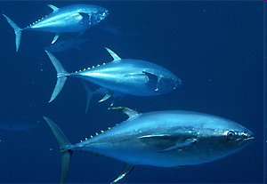
Writing a Report
Good communication is extremely important –
Motivate the reader
Structure the thesis – Make it look like a fish
Introduction → Fat
Literature Review → Fatish
Method → Fat
Experiments & Evaluation→ Fatish
Afterword → Thin
ALWAYS BE SURE TO ACKNOWLEDGE OTHERS
Tuna like
Notes:
12

Slide 13
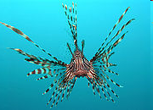
Writing a Report
Good communication is extremely important –
Motivate the reader
Structure the thesis – Make it look like a fish
Introduction → None
Literature Review → Fatish
Method → Fat
Experiments & Evaluation→ Fatish
Afterword → None
ALWAYS BE SURE TO ACKNOWLEDGE OTHERS
Lionfish
Notes:
13

Slide 14
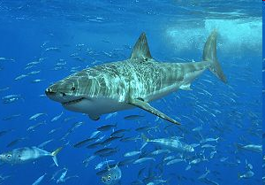
Writing a Report
Good communication is extremely important –
Motivate the reader
Structure the thesis – Make it look like a fish
Introduction → Thin
Literature Review → Fat
Method → Fat
Experiments & Evaluation→ Thin
Afterword → Sprawling
ALWAYS BE SURE TO ACKNOWLEDGE OTHERS
Shark
Notes:
14

Slide 15

Writing a Report
Good communication is extremely important –
Motivate the reader
Structure the thesis – Make it look like a fish
Introduction → Fat
Literature Review → Fatish
Method → Fat
Experiments & Evaluation→ Thin
Afterword → Thin
ALWAYS BE SURE TO ACKNOWLEDGE OTHERS
Shark
Notes:
15

Slide 16
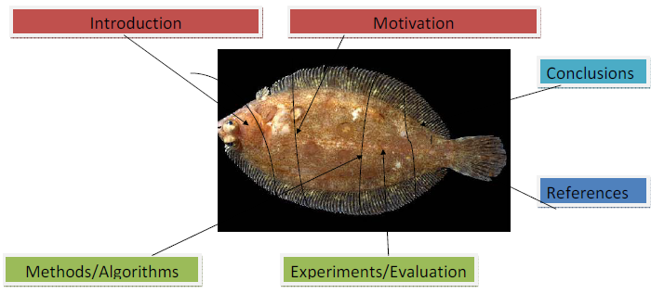
Writing a Report
Good communication is extremely important –
Motivate the reader
Structure the thesis – Make it look like a fish
Introduction → Thin
Literature Review → Fatish
Method → Fat
Experiments & Evaluation→ Fatish
Afterword → Thin
ALWAYS BE SURE TO ACKNOWLEDGE OTHERS
Lemon Sole
Notes:
16

Slide 17
Doing Science?
NO | YES
The object under study was displaced horizontally | The ball moved sideways
On an annual basis | Yearly
Endeavour to ascertain | Find out
It could be considered that the speed of storage reclamation left something to be desired | The garbage collector was really slow
Notes:
17

Slide 18
The purpose of your research proposal is not...
Writing a Research Proposal
To describe the WizWoz system
Your reader does not have a WizWoz
She is primarily interested in re-usable brain-stuff, not executable artefacts

Slide 19
Contributions should be refutable
Writing a Research Proposal
NO! | YES!
We describe the WizWoz system. It is really cool. | We give the syntax and semantics of a language that supports concurrent processes (Section 3). Its innovative features are...
We study its properties | We prove that the type system is sound, and that type checking is decidable (Section 4)
We have used WizWoz in practice | We have built a GUI toolkit in WizWoz, and used it to implement a text editor (Section 5). The result is half the length of the Java version.
Simon Peyton Jones, Microsoft Research, Cambridge

Slide 20
The truth: credit is not like money
Writing a Research Proposal
Giving credit to others does not diminish the credit you get from your paper
Warmly acknowledge people who have helped you
Be generous to the competition. “In his inspiring paper [Foo98] Foogle shows.... We develop his foundation in the following ways...”
Acknowledge weaknesses in your approach
Simon Peyton Jones, Microsoft Research, Cambridge

Slide 21
Credit is not like money
Failing to give credit to others can kill your paper
If you imply that an idea is yours, and the referee knows it is not, then either
You don’t know that it’s an old idea (bad)
You do know, but are pretending it’s yours (very bad)
Simon Peyton Jones, Microsoft Research, Cambridge

Slide 22
Plagiarism: THE SCHÖN SAGA
October 2001:
Hendrik Schon and Zhenan Bao: A single molecule transistor made out of organic material;
The end of silicon-based, highly toxic process of making transistor involving rare metals;
The new world of freely available organic molecules to build transistor.

